Slide 1
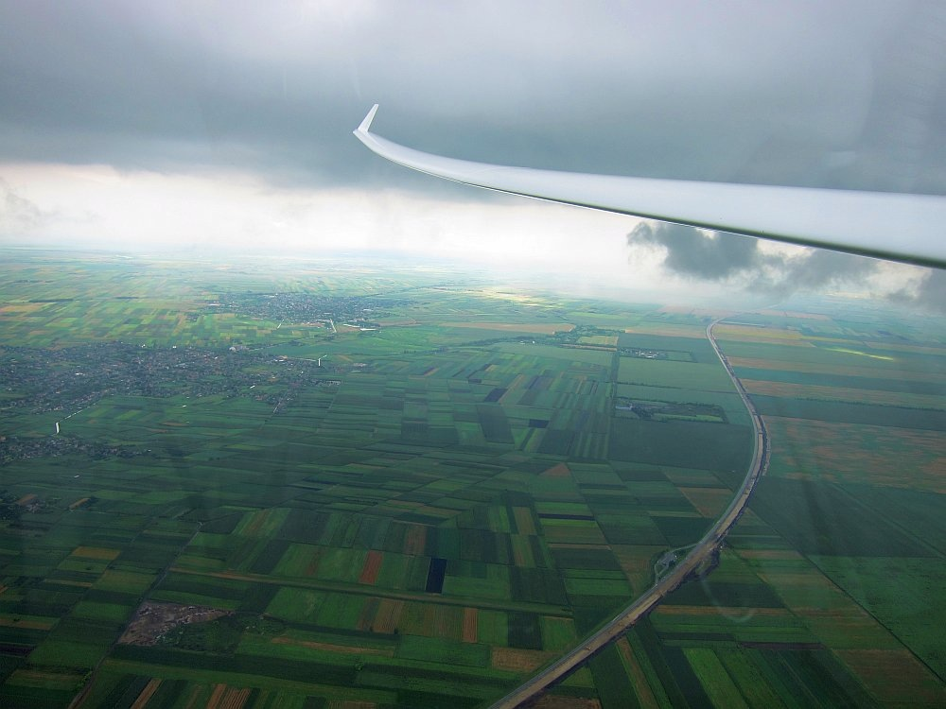
Cross-Country for Beginners
Part 4: Cruising and In-flight Decision Making
Bill Elliott and Rand Baldwin

Slide 2
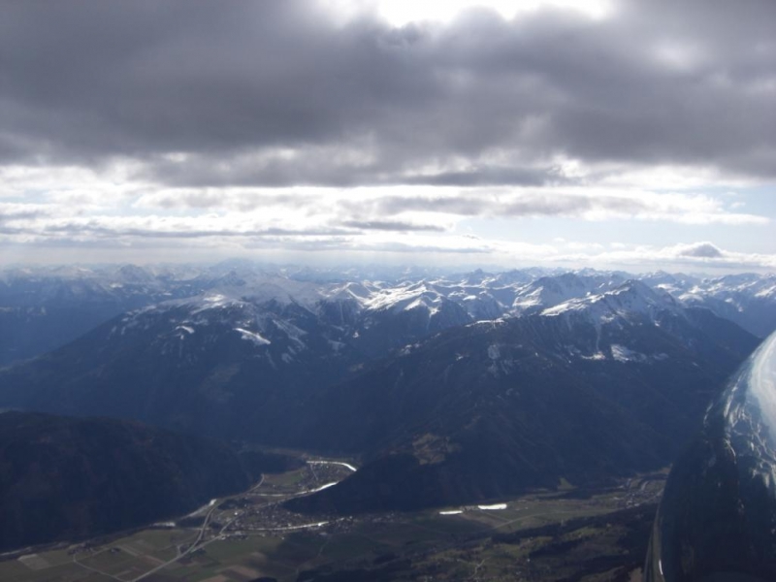
Six Week Agenda
  Weather and Preparation (needed skills, glider & instrumentation, biological)
  Thermals and Triggers
  Climbing—and the art of thermaling
  Cruising and In-Flight Decision Making
  Flight Computers and Final Glides
  Outlanding and Post-Flight Analysis

Slide 3
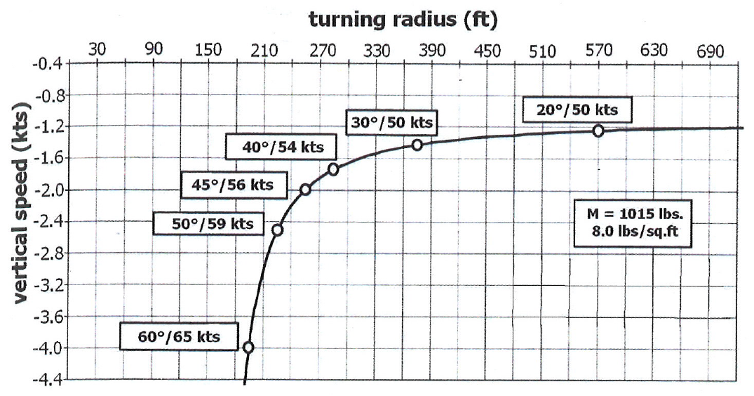
Optimal Turning Radius
Optimum is about 40 to 45 degrees or 18 to 20 seconds – keep your speed up!
Too little gain --
Increasingly more
difficult to control
bank and speed.
Best
< 500 ft
Better
Still Too Big
Too Big
•
•
•
•
Small increase in sink rate
Big increase in climb rate
Huge increase in sink rate
•
BGD, p. 45

Slide 4
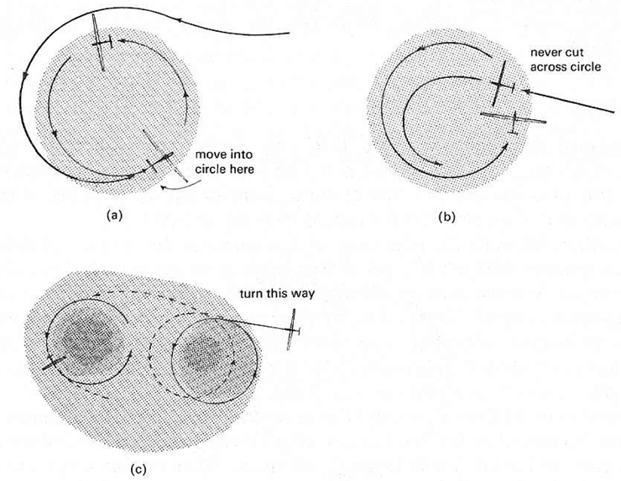
Joining a Gaggle
3
4
6
2
1
1
5
2
5
6
4
3
(a) Always join outside their circle and only move in when on the opposite side.
3
2
1
(b) Never join by cutting across another pilot’s circle
or pulling up into the circle.
3
1
2
(c) Always circle in the same direction as any nearby glider to make joining each other safe and simple.

Slide 5
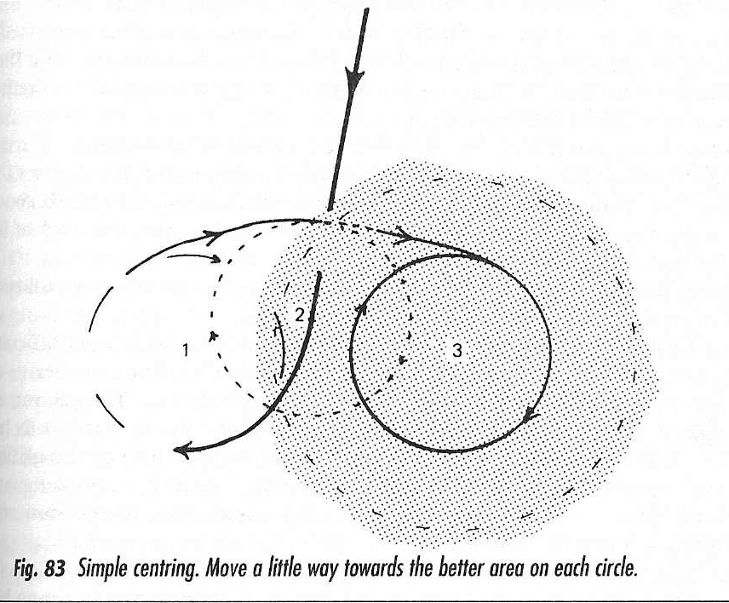
Simple Centering
Committing to a 40 - 45 degree turn,
rather than broad exploratory turns, will help you keep track of the thermal.
1. Contact Lift, Time Turn,
and Initiate 45 degree Turn
3. Adjust towards core,
keeping turns tight.
Never go through the same “bad air” twice!
2. No Lift—turned the wrong way;
but, you know where the lift is.
Adjust circle towards lift.
4. Never lose track of
where the thermal is.

Slide 6
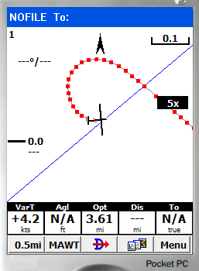
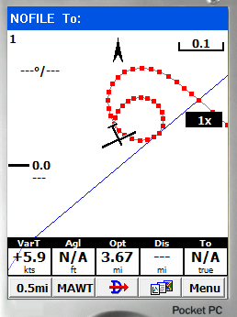
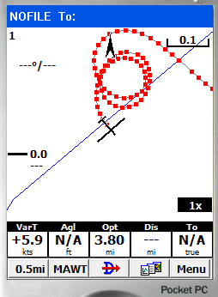
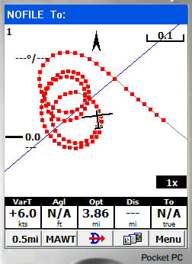
Use your PDA – Zoomed in!
First turn. Got an idea where the thermal is?
How about now?
Exploratory?
You only have to glance at the PDA for the information
I’ll bet any of you could find your way back to the core, huh?

Slide 7
Which Way to Turn?
This just takes lots of practice to get right – that is some of the time!
Sometimes, I feel like if I try to pick I am 75% wrong,
while simple always going left only makes me wrong 50% of the time.
Fly through the core,
Both choices are equal
Just off Center,
hard to detect best direction,
just commit.
Core is to the right,
Try to detect wing lift,
Much larger mistake
if wrong direction.
Notes:
The further the entry course line is from a diameter, the greater the cost of a wrong way turn. There is little to be done about this however since we cannot know on approaching a thermal where the center is.
A) No need to worry - both ways are wrong, and there is no way to distinguish.
B) Right turn is favored, but unless the right wing lifts prior to the turn, the pilot does not know this.
C) The sufficiently lucky or sufficiently skillful pilot can perfectly time the turn, get the direction right, and be centered almost immediately.

Slide 8
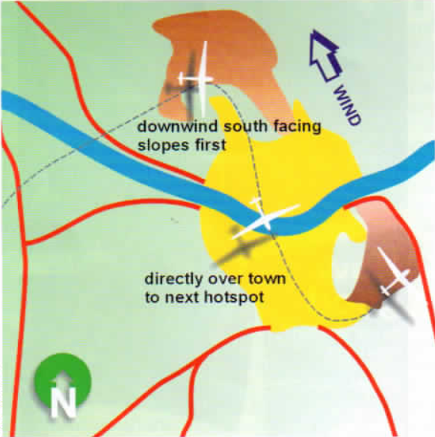
Find Lift on Blue Days
Look for the “Hot Spots” and
Identify the best trigger sources.
Fly the infrastructure
Fly the trigger points
Look for wind shaded,
south-facing areas
Go to any High Ground
Look for all the same signs as if you are low
Look for Haze Domes
Remember, streets form on blue days too.
Blue days can be just as fun as days with Cu

Slide 9
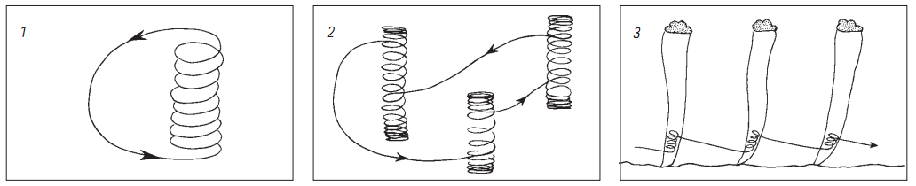
Practice (as usual) makes perfect (or at least safer)
Routinely practice the following at the end of the day with any excess altitude (well above pattern, of course, and after clearing turns)
18 second circles, 55 knots, 45 degree bank
15 second circles, 65 knots, 55 degree bank
Enter/Exit/Change Direction
Rigid Adherence to constant speed/bank angle
Yaw string in the middle – no “speed brakes”
Note constantly change in required rudder position for bank angle. Most pilots under rudder when they increase bank and over rudder when they reduce bank.
Get to Know your Airplane – It’s easy to spin from a tight turn
Notes:
Must have full command of the glider and practice makes perfect
Most glass gliders WILL spin, contrary to popular notions. Try this in yours – well away from everyone – you’ll be surprised. But then you’ll recognize and be able to avoid

Slide 10
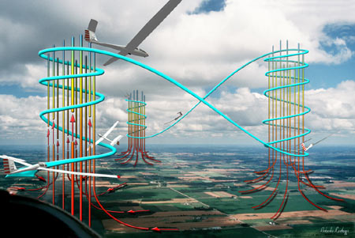
Today’s Agenda: Cruising
Aircraft Polars, Speed-to-Fly, and MacCready.
Which is more important: Climb or Cruise?
How fast to Cruise
  Speed to fly
  What MacCready Setting to Use
  Consequences of wrong Mc Setting
Use of the “Height Band”
Cost of Course Deviations

Slide 11
Speed to Fly
The “Speed to Fly” is the cruising speed that maximizes either glide ratio or average cross country speed.
Maximize:
  Glide ratio through the air
    Get to the next thermal at max. altitude
  Glide ratio over the ground
    Go as far as possible before landing
  Average Cross Country Speed
    Racing or long tasks
Final Glide
  Glide to a point on the ground
    When to start and how fast to fly

Slide 12
Minimum Sink Speed
Speed for Min. Sink
Airspeed (kts)
0
20
40
60
80
100
120
0
Minimum Sink
-1
-2
-3
-4
-5
Sink Rate (kts)
-6
-7
-8
-9
-10

Slide 13
Best Glide Ratio
Best Glide Speed (or Max L/D)
Airspeed (kts)
0
20
40
60
80
100
120
0
-1
-2
Tangent to Polar
-3
-4
-5
Sink Rate (kts)
-6
-7
-8
-9
-10

Slide 14
Best Glide Speed in a Headwind
Best Glide Speed: 52 kts
20 kt Headwind
Airspeed (kts)
0
20
40
60
80
100
120
0
-1
o
-2
-3
-4
-5
Still Air
Best Glide Speed: 45 kts
Sink Rate (kts)
-6
-7
-8
-9
-10

Slide 15
Best Glide Speed in a Tailwind
Best Glide Speed: 40 kts
20 kt Tailwind
Airspeed (kts)
0
20
40
60
80
100
120
0
-1
o
o
o
-2
-3
Min. Sink: 37 kts
-4
-5
Still Air
Best Glide Speed: 45 kts
Sink Rate (kts)
-6
-7
-8
-9
-10
In a Tailwind, Best Glide Speed is Between
Still Air Best Glide and Minimum Sink Speeds.

Slide 16
Rules of Thumb
Headwind
  Fly Still Air Best Glide Speed + 1/2 Headwind
Tailwind
  Fly Still Air Best Glide Speed - 1/4 Tailwind
  But Not Slower Than Minimum Sink Speed!

Slide 17
Going Faster
4
Extend the Sink Rate Axis Above Zero
to Represent Climb Rates in Thermals
3
2
Climb Rate (kts)
1
Airspeed (kts)
0
20
40
60
80
100
120
0
-1
-2
-3
-4
-5
Sink Rate (kts)
-6
-7
-8
-9
-10

Slide 18
Going Faster: Speed to Fly
4
Select the Climb Rate Expected
in the Next Thermal and Draw a Tangent
Line From it to the Polar
3
o
2
Climb Rate (kts)
1
Airspeed (kts)
0
20
40
60
80
100
120
0
-1
Speed to Fly
is 65 knots
-2
o
-3
-4
-5
Sink Rate (kts)
-6
-7
-8
-9
-10

Slide 19
Going Faster: Average Speed
4
Tangent Cuts the Airspeed Axis
at the Average Cross Country Speed:
34 knots in This Example
3
2
Climb Rate (kts)
1
Airspeed (kts)
0
20
o
40
60
80
100
120
0
-1
-2
o
-3
-4
-5
Sink Rate (kts)
-6
-7
-8
-9
-10

Slide 20
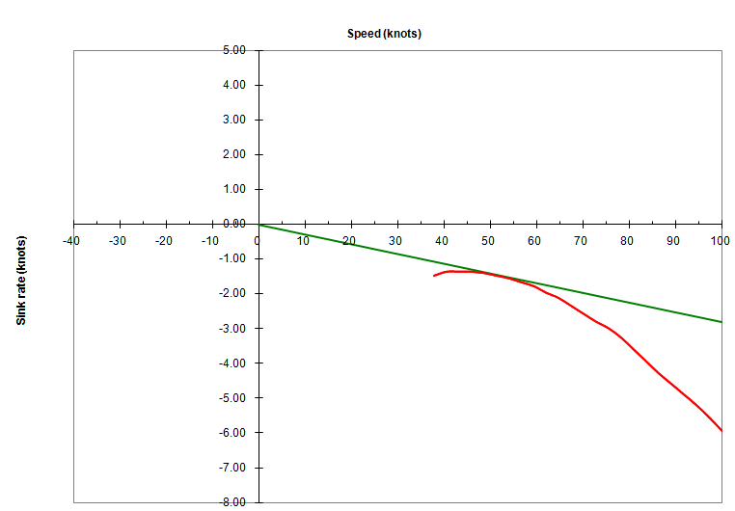
Determining STF Graphically
Polar for Speed Astir CS
⧫
⧫
⧫
⧫
⧫
⧫
Reichmann’s Major Contribution was Graphical Explanation of Speed to Fly Theory

Slide 21
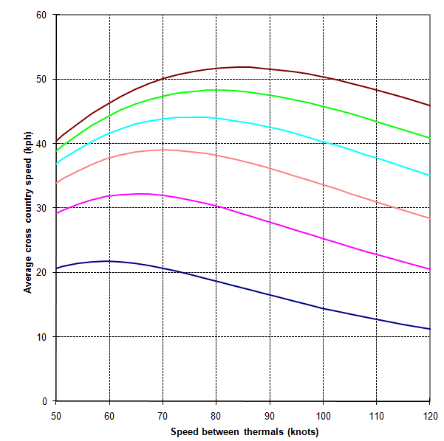
Average Speed is Mostly about Climb Rate
Family of curves show
Average Cross-County Speed as function of
Cruising Speed and Climb Rate
6 Kt
5 Kt
4 Kt
Very little penalty for flying slower than desired
Average Cross-Country Speed (kts)
3 Kt
Flying 60 or 70
yields same speed
To achieve higher cross-country speeds, you must climb faster!
2 Kt
1 Kt
Good use of energy lines can increase speeds more.
Cruising Speed (kts)

Slide 22
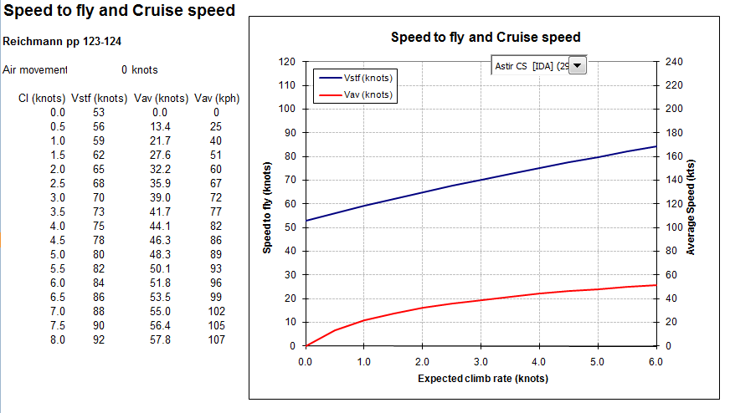
STF for Astir CS Plotted with Average Cross-Country Speed
⧫
⧫
⧫
⧫
⧫
⧫

Slide 23
Look at Polar10.xls

Slide 24
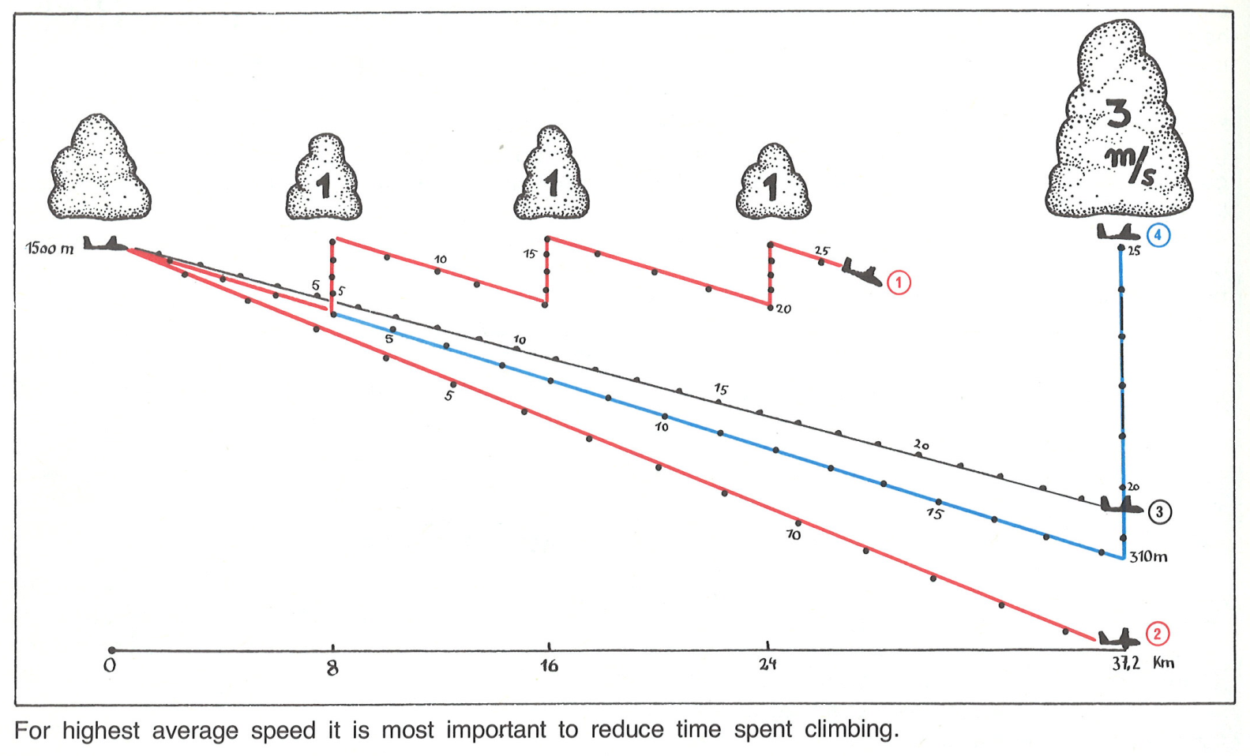
Consequence of Speed to Fly Choice
This pilot has a nice series of Cu ahead, how fast should he fly?
Let’s look at four possibilities and look at the implications.
1
Glider 1 will set his Mc = 2 kts and fly 75 mph.
2
Glider 2 will set his Mc = 6 kts and fly 95 mph.
3
Glider 3 is not concerned with Mc setting so he will set off at best L/D or 55 mph.
4
Glider 4 will set his Mc = 2 kts and fly 75 mph; but he is going for the good lift.
What speed and what thermals to take will cruising on course is always a tough decision.
Fly to slow and you simple waste valuable time.
Fly to fast and you take too much risk increasing the risk of landout.
Reichmann, p. 58

Slide 25
Consequence of Speed to Fly Choice
Five minutes into the flight, everything looks okay.
1
Glider 1 decides to moderate speed but willing to take weak lift.
3
Glider 3 flies slow to ensure he reaches the good lift.
4
Glider 4 flies same speed as 1 but passes up weak lift.
2
Glider 2 is “going for it!”.
Reichmann, p. 58

Slide 26
Consequence of Speed to Fly Choice
Ten minutes into the flight, now there is a big difference
1
Glider 1 is poking along taking all available lift.
3
Glider 3 is slightly ahead.
4
Glider 4 should reach big Cu just fine.
It is still hard to say who is making the best decision.
2
Glider 2 is desparately low.
Reichmann, p. 58

Slide 27
Consequence of Speed to Fly Choice
Fifteen minutes into the flight—”Splash One!”
1
Glider 1 is loving cloudbase
and is now many minutes behind.
3
Glider 3 is well ahead
of 2 with plenty of options.
Okay, so, clealy you can fly to slow and too fast.
4
Glider 4 must
get the thermal.
Glider 2 hits the dirt!.
2
Reichmann, p. 58

Slide 28
Consequence of Speed to Fly Choice
Twenty minutes into the flight and Glider 4 is now well ahead.
1
Glider 1 is comfortably high but well behind.
Glider 3 not much higher than 4 but behind.
3
4
Glider 4 is well ahead and climbing well at 6 kts.
Glider 2 has a great view of what is happening above.
2
Reichmann, p. 58

Slide 29
Consequence of Speed to Fly Choice
For highest average speed,
it is most important to reduce time spent climbing.
Glider 1 is
8 minutes behind.
Glider 3 is 5.5 minutes behind and ahead of
Glider 1 by 2.5 minutes.
Glider 1 takes 33 minutes.
Glider 3 takes 30.5 minutes.
Glider 4 is 30% faster than 1 and 20% than 3.
Glider 2 has made contact with his crew.
Cruising speed has some effect; however,
taking the best thermals is far more important.
2
Reichmann, p. 58

Slide 30
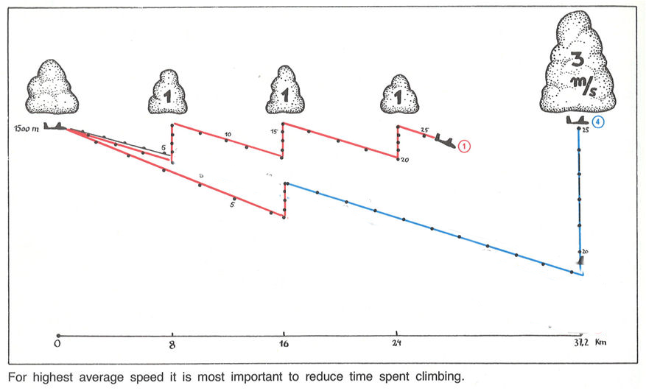
Consequence of Speed to Fly Choice
So, what could have Glider 2 done to save his flight?
2
Glider 2 should realize his mistake of flying too fast, stop and climb
enough to reach the big cloud, reset his Mc = 2 kts and continue cruising.
2
Always adjust cruise speed as necessary and take
lesser climb rates just as enough to get to the better climb.
Glider 2 is now 2 minutes behind Glider 4 and ahead of gliders 1 and 3.
Reichmann, p. 58

Slide 31
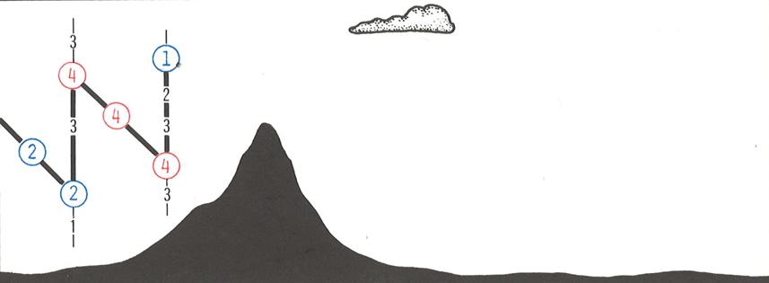
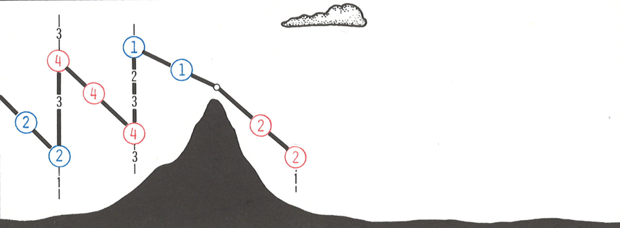
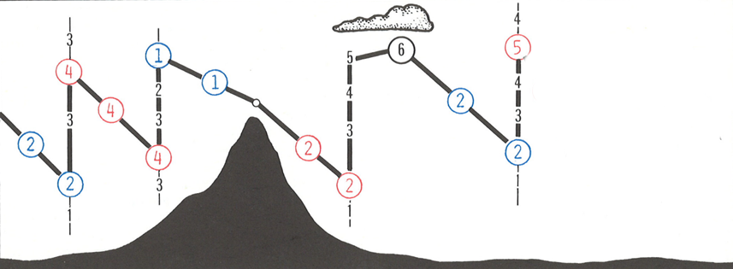

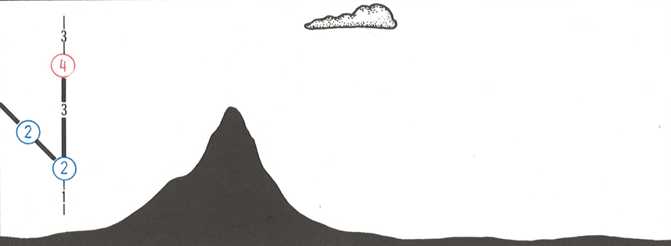
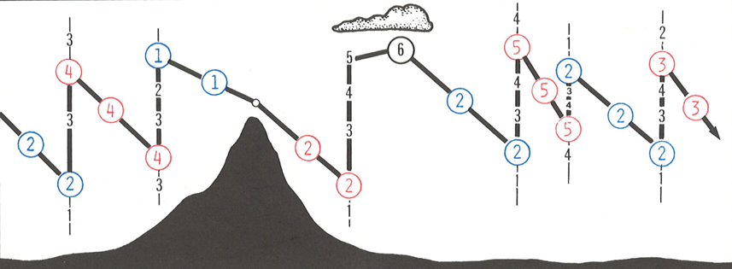
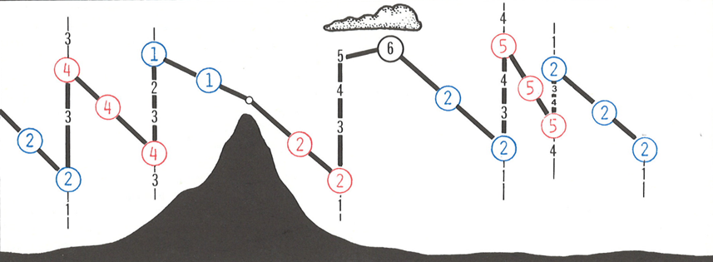
MC Settings must be chosen carefully
While cruising, your
Current Mc Setting = Initial Climb Rate of Next Thermal
And, if you can, you should leave the thermal when
Current Climb Rate = Initial Climb Rate of Next Thermal
Reichmann, p. 60

Slide 32
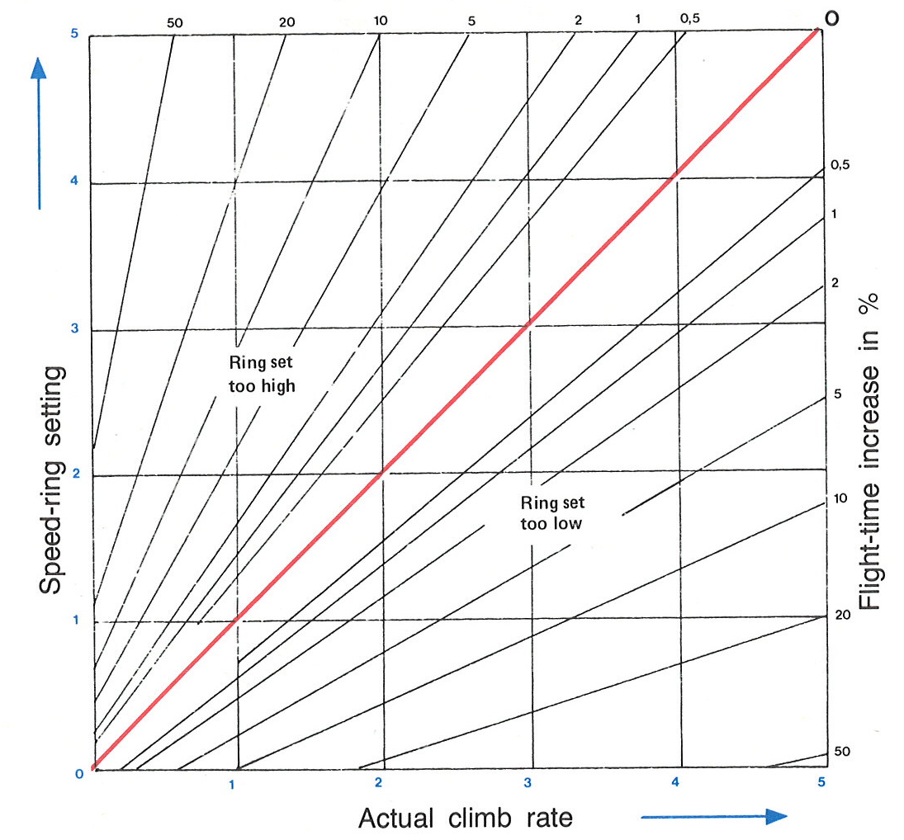
Speed Decrease Due to Wrong STF Choice
In practice, MC Settings > 3 are rare.
Strong Day
1.5% Increase
Weak Day
9% Increase
> 30% Increase
Reichmann, p. 61

Slide 33
Maximizing Average Speed
Speed to Fly Errors Have a Small Effect on Average Cross Country Speed
  Err on low side
    Flatter glide ratio
    Better chance of finding the next thermal
It’s Better to Fly Too Fast in Lift Than Too Slow in Sink!
Climb Rate is Much More Important
  Only circle in the strongest thermals
  Get centered quickly
  Leave when climb rate drops to the initial climb rate expected in the next thermal

Slide 34
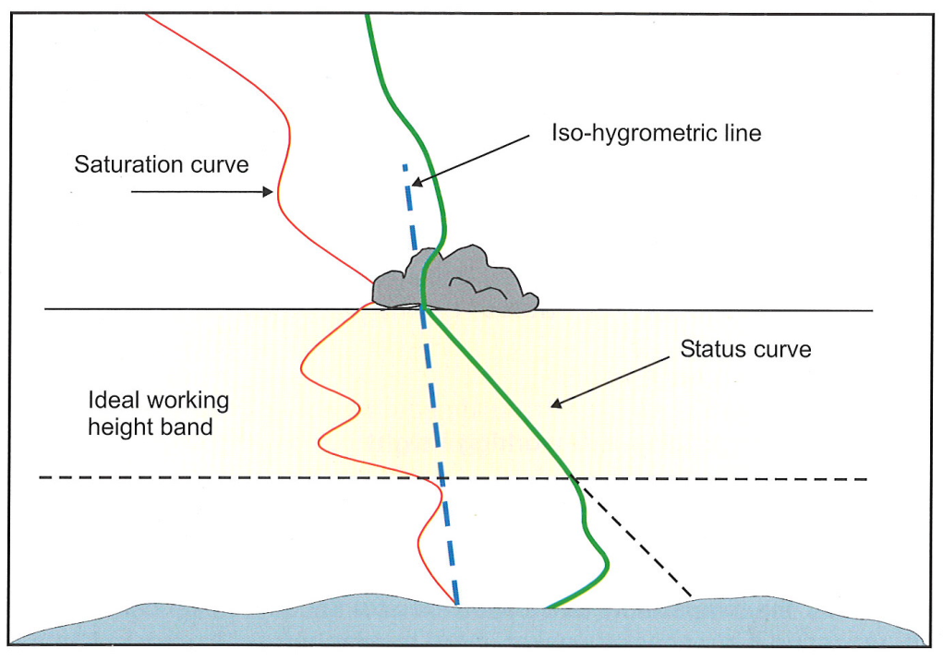
Typical Working Height Band
The “Ideal Working Height Band” on a typical day is usually the top 50% to 60% of the Maximum Height of the Usable Lift
Below this region, thermals are generally smaller, weaker, less organized and generally more difficult to center and climb.
Try to determine the lower end of the region before you start.
Be aware that it may (probably will) change during the day.
WWTM, p. 76

Slide 35
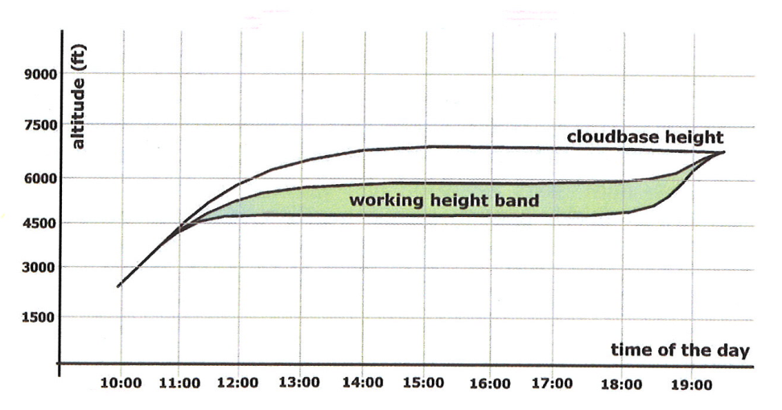
Working Height Changes During the Day
The lower region will rise as the day progresses and then often rises again towards the end of the day.
It is not unusual for thermal strength to decrease towards the top.
BGD, p. 102

Slide 36
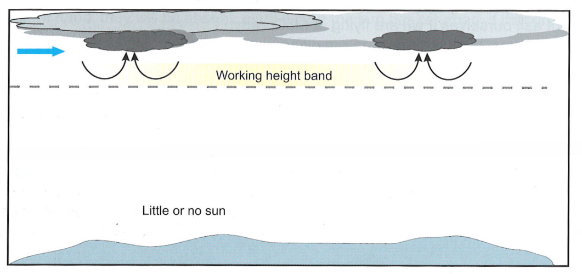
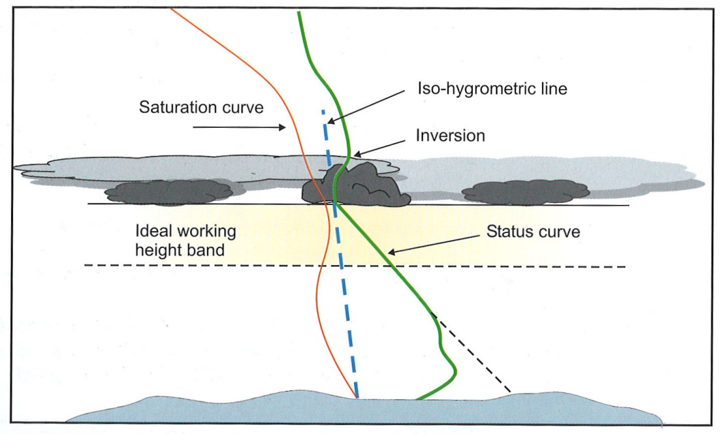
Spread-out Raises the Height Band
Lift will be within
1000 feet of Cloudbase and often widespread.
WWTM, p. 86

Slide 37
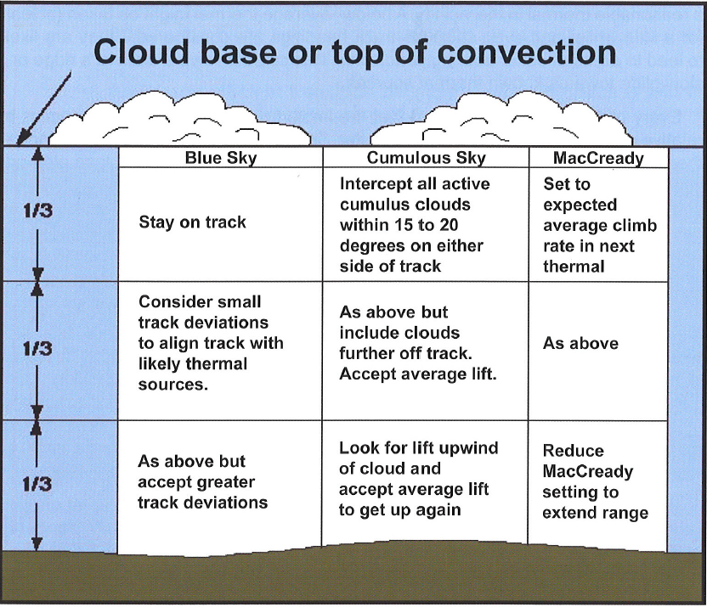
STF in the Height Band
ASME, p. 157

Slide 38
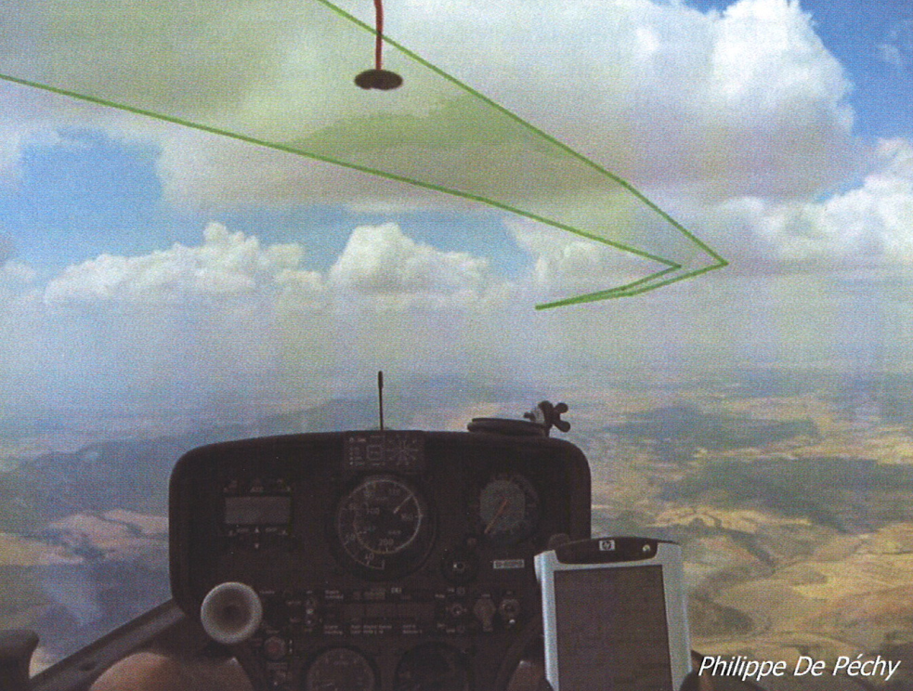
Plan your flight path as far ahead as you can see.
BGD, p. 115

Slide 39
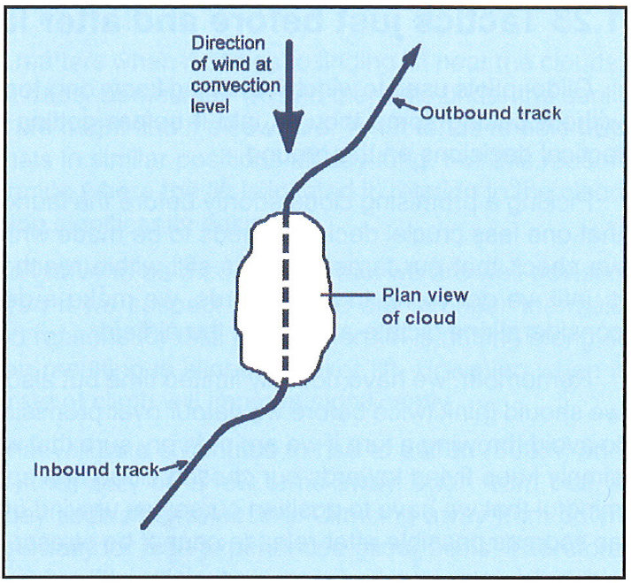
Align Your Search with the Wind
ASME, p. 45

Slide 40
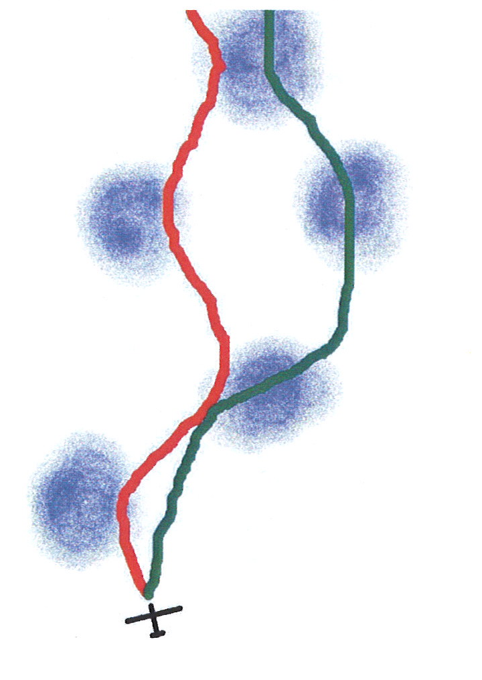
“Commit” to Searching
Commit to flying through the most likely areas of lift under clouds even though you may encounter sink along the way. (green path)
Don’t shy away from clouds with sink. (red path)
Sink is to be expected and is usually a sign that lift is nearby
BGD, p. 116

Slide 41
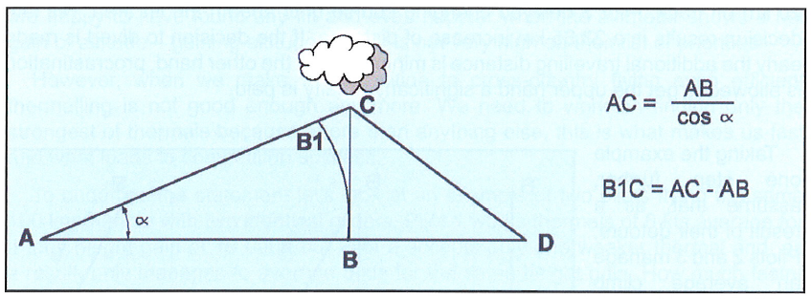
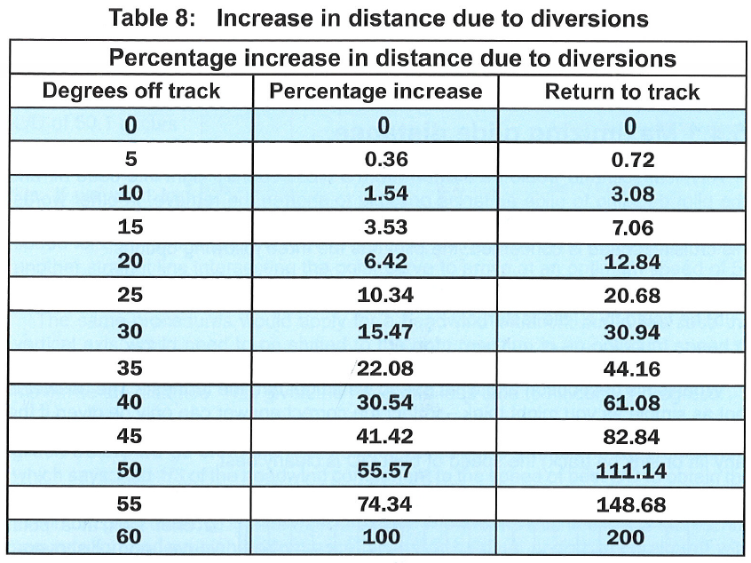
The Cost of Deviations
Deviations are necessary
Be conscious of the angle of the deviation.
Small angles are okay.
Larger angles rapidly increase the penalty for the deviation.
Deviate for:
  Expected Higher Rates of Climb
  For “Cloud Fields”
  For “Cloudstreets”
  Deviations Greater than 30 degrees are for emergencies or for exceptionally better lift.
ASME, p. 150-151

Slide 42
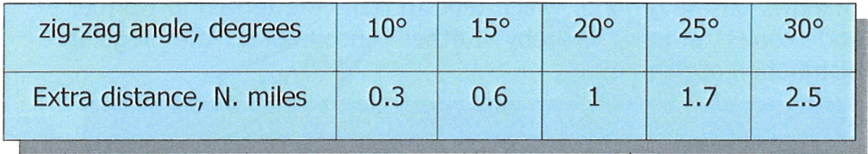
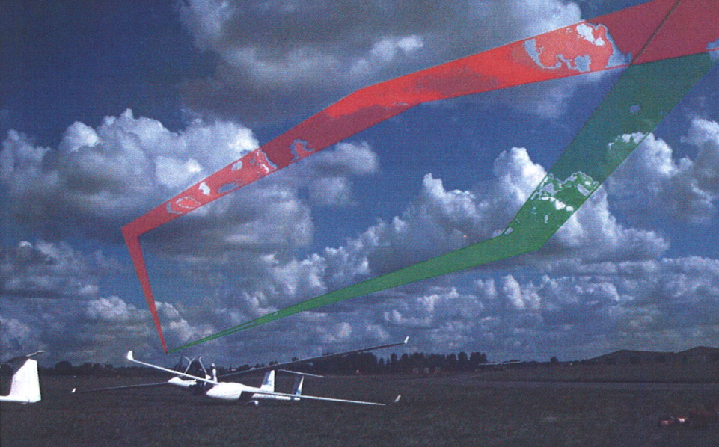
Another example of deviations
BGD, p. 117

Slide 43
Six Week Agenda
  Weather and Preparation (needed skills, glider & instrumentation, biological)
  Thermals and Triggers
  Climbing—and the art of thermaling
  Cruising and In-Flight Decision Making
  Flight Computers and Final Glides
  Outlanding and Post-Flight Analysis

